Slide 1
Loan Sanction Amount Prediction

Slide 2
Loan Sanction Amount Prediction
Here we are going to predict the amount to be sanctioned to client based on the available data.
Instead of predicting whether to issue loan or not in ‘Yes’ or ‘No’ ,here we have to predict the loan issue amount.
We are going to discuss and implement data visualisation and then feature engineering, feature selection and at last model selection and evaluation.
We are going to discuss in detail about the concept behind each step.

Slide 3
Contents
Dataset Description
Exploratory Data Analysis
Feature Engineering
Feature Selection
Model Training and Evaluation
Comparison
Conclusion

Slide 4

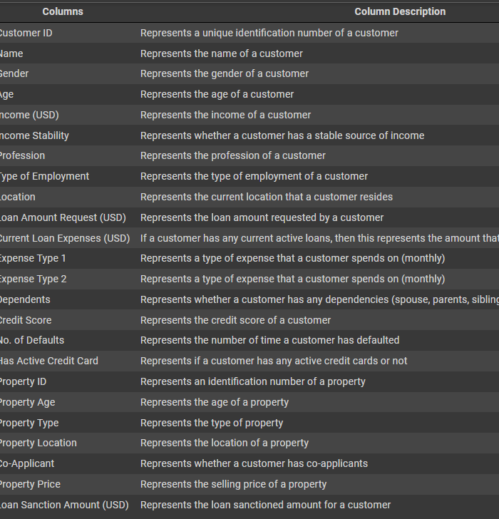
Dataset Description
Overview of the dataset is provided beside.
Dataset consists of 30000 rows and 24 features.
Target column is Loan_Sanction_Amount.
Features include information about each client based on the previous record.

Slide 5
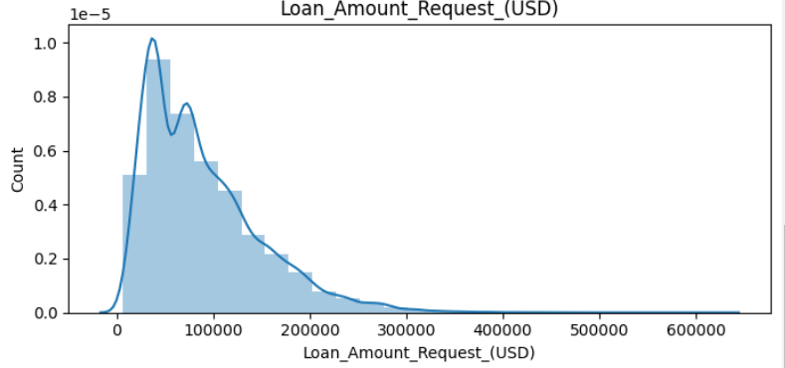
Exploratory Data Analysis
Missing Values- There are 12 columns with missing values which is to be filled with mean, median or mode based on its distribution curve.
Numerical Variables – Contains 4 Discrete and 9 Continuous variable
Distribution of the Numerical Variables – Here through plotting distplot of each curve we observed that whether these curves are normal distribution, left skewed or right skewed. Like shown in figure this is left skewed curve.
Categorical Columns – There are 10 categorical columns in
the dataset.

Slide 6

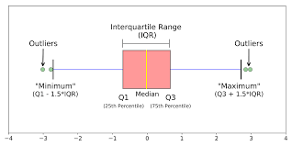

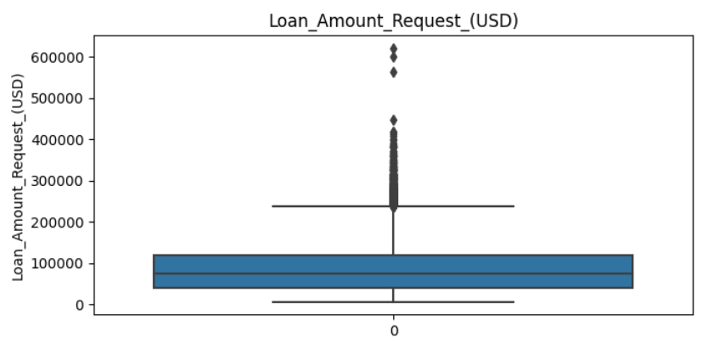
Exploratory Data Analysis
5. Outliers – Here we identify whether outliers are present in continuous features or not through boxplot. Like in Loan_Amount_Request_(USD) column, we can see that there are dotted portion above the line which is outliers. The outliers are below the minimum(Q1-1.5*IQR) or above the maximum(Q3+1.5*IQR).

Slide 7
Feature Engineering
We will be performing all the below steps in Feature Engineering-
Outlier Handling
Missing values
Encoding Categorical Variables
Standardization of Variables

Slide 8
Feature Engineering - Outlier Handling
Why to handle outliers?
Outliers can have significant effect on statistical measures like mean and standard deviation thus making the graph more skewed.
Statistical models can have great impact on its performance. These models are sensitive to extreme values.
Also while visualizing the data it becomes very difficult to visualize it.
Sometimes Outliers are due to measurement errors or data entry issues.

Slide 9
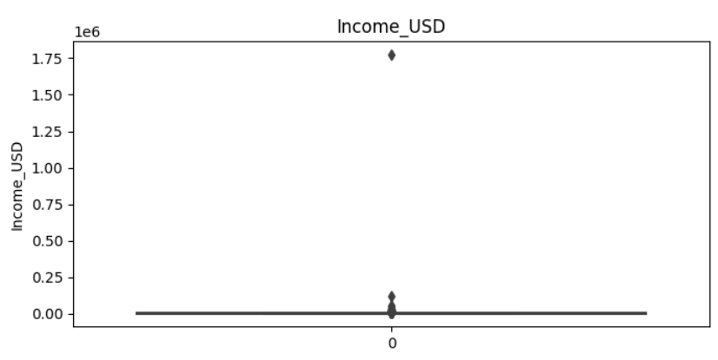
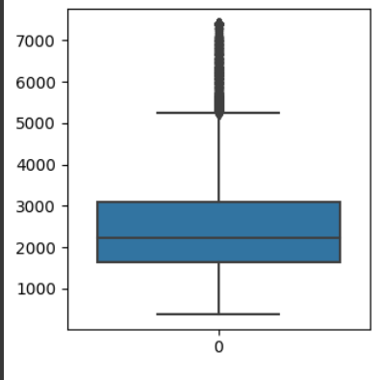
Feature Engineering - Outlier Handling
Here we replaced all the outliers above or below the maximum or minimum with (Q1-3*IQR) and (Q3+3*IQR).
Data falling above or below (Q1-3*IQR) and (Q3+3*IQR) are extreme outliers and above or below (Q1-1.5*IQR) and (Q3+1.5*IQR) are outliers.
So instead of replacing outliers we replaced extreme outliers for more robust model so that it can be trained on few extreme points.
After outlier handling

Slide 10
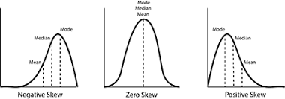
Feature Engineering– Filling Missing Values
Here we filled the missing values either with mean or median.
In case of left skewed and right skewed filling the missing values with median is preferred. The median represents the middle value which makes it more suitable for skewed graph distribution besides mean which is very sensitive to outliers.
Hence after filling values, graph can be similar to normal distribution.
In case of categorical variables, missing values are
filled with mostly mode as the missing percentage
was very less.

Slide 11
Feature Engineering- Encoding Categorical Variables
Here label encoder is applied for categorical column as there were less categories.
In label encoder, each category is assigned with integer label.
Like here in Gender column – Male and Females: Male is replaced with 1 and Female with 0.
Encoding is done because ML models are incompatible with categorical variables and can help algorithms find patterns and make predictions more accurately.
Gender | Label
Male | 1
Female | 0

Slide 12
Feature Engineering- Standardization
If dataset has extremely high or low values (outliers) then standardization is more preferred because it centers the data around mean of 0 and standard deviation of 1..
Standardization scales all the features to have a mean of 0 and a standard deviation of 1.
Many machine learning algorithms, like support vector machines, use the distance between data points. Features on different scales can lead to incorrect or suboptimal model performance.
Gradient descent, a commonly used optimization technique in machine learning, converges faster when features are standardized. This means your model may train more quickly and efficiently.
Standardization can make your models more robust, particularly to outliers. Standardizing the data reduces the impact of extreme values on the model.

Slide 13
Feature Selection
It involves choosing a subset of relevant features from the available set of features to build a model.
Including irrelevant or redundant features in a model can lead to overfitting, where the model performs well on the training data but poorly on unseen data.
Models with fewer features are generally simpler and easier to understand.
High-dimensional data can suffer from the "curse of dimensionality," where the number of features becomes so large that the data becomes sparse and difficult to model effectively.
Here correlation matrix is chosen for feature selection because features with high +ve or -ve correlations are likely to be good predictors, as they have a strong influence on the target variable. Selecting such features can lead to more accurate predictive models.

Slide 14
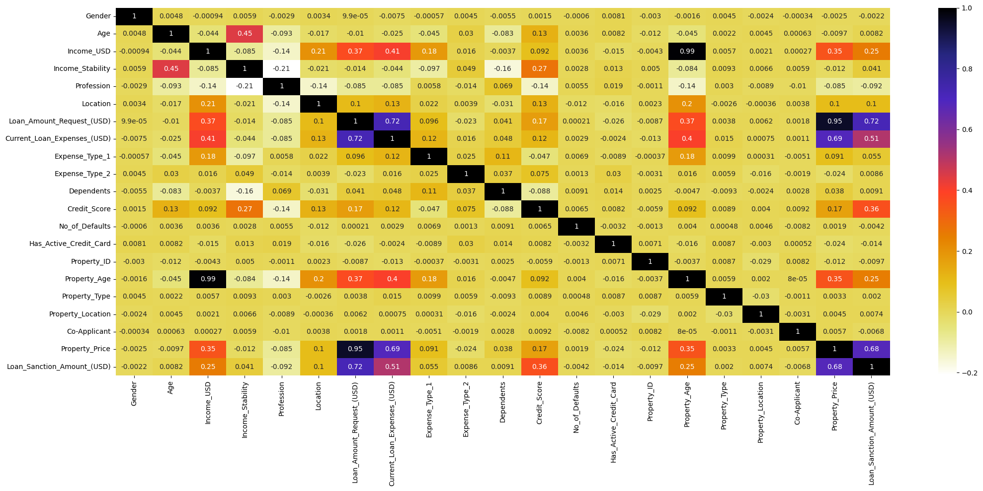
Feature Selection
Highly correlated variable with target variable are: Income_USD, Location, Loan_Amount_Request, Current_Loan_Expenses (USD), Credit_Score, Property_Age, Property_Price, Profession.
Features reduced from 22 to 8.

Slide 15
Model Training and Evaluation
Here two models are used i.e Random Forest and SVM regressor.
Evaluation metrics used are R2 Score, RMSE and MAE.

Slide 16
Model Training and Evaluation- Random Forest
It is an ensemble model that combines the predictions of multiple decision trees, reducing overfitting and improving the overall accuracy of the model.
In loan sanction prediction, accuracy is crucial to ensure that the right applicants receive loans while minimizing the risk of default.
Random Forest is capable of capturing these non-linear patterns, making it well-suited for modeling the decision-making process.
It is relatively robust to outliers, as it is less influenced by individual data points.
It can scale well with additional data, making it suitable for large loan application datasets.

Slide 17
Model Training and Evaluation- SVM
SVMs are effective when working with high-dimensional datasets, which is often the case with loan sanction prediction.
SVMs can effectively handle non-linear relationships in the data using kernel functions.
SVMs are less sensitive to outliers compared to some other algorithms.
They are sensitive to the choice of kernel and hyperparameter tuning requirements.
Additionally, SVMs may be computationally intensive for large datasets.

Slide 18
Model Training and Evaluation- Metrics
Models | MAE(Lower) | RMSE(Lower) | R2 Score(Higher)
Random Forest | 0.3570 | 0.4968 | 0.7342
XGBoost | 0.3718 | 0.5128 | 0.6781
RMSE: It gives the average size of the errors made by the model. Smaller RMSE values indicate better accuracy, but it is sensitive to outliers.
MAE: It provides the average magnitude of errors. It's a good choice when you don't want to be overly affected by outliers. Lower MAE is preferred.
R²: It tells how much of the variance in the target variable is explained by the model. A higher R² value indicates a better fit.
Combination: RMSE to assess accuracy, MAE to understand the typical error size, and R² to evaluate the goodness of fit.

Slide 19
Why Random Forest perform better?
Large Datasets
Less Feature
Nonlinear relationship between dependent and independent variable
Less outliers

Slide 20
Conclusion
Thus, we discussed in detail about end to end ml approach for loan sanction amount prediction.
Feature engineering and feature selection plays very important role for better model performance.
Thus, it depends on data type and requirement to choose correct model.
Code link
Dataset Link

Slide 21
Thank You

